Slide 1
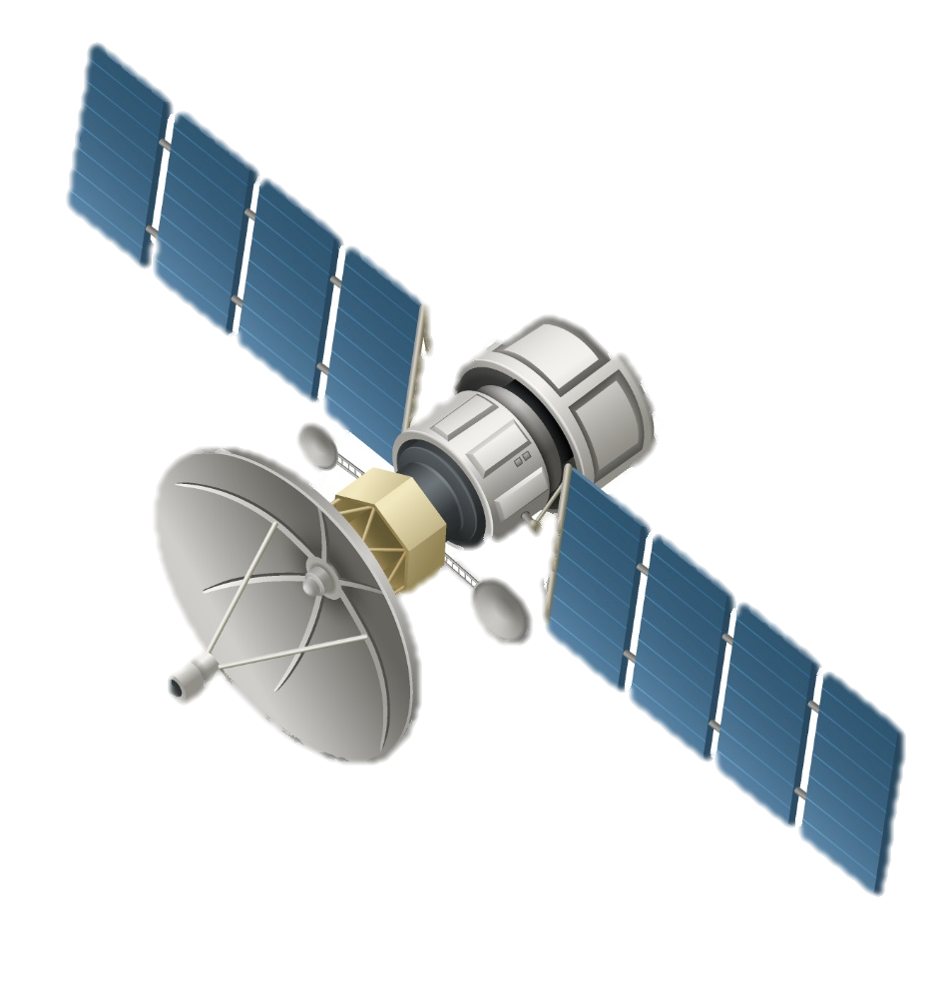


LEO satellites
Applications
Satellite | Altitude | Band | Quantity
Xona | 525 km | L, C | 258
OneWeb | 1,200 km | Ku | 648
Starlink Gen. 1 Starlink Gen. 2 | 335.9--570 km 340--614 km | Ku, Ka, V | 11,926 30,000
Orbcomm Gen.1 Orbcomm Gen.2 | 720 km 750 km | VHF | 36 18
··· | ··· | ··· | ···
Sec. II: Single-satellite single-RIS snapshot positioning
- Low complexity
- Low accuracy and requires long observation duration
Sec. III: Multi-satellite multi-RIS snapshot positioning
- High accuracy
- High complexity and restriction
Sec. IV: Multi-satellite multi-RIS dynamic user tracking
- High accuracy
- Robust across different environments
···
LEO satellite
RIS 1
RIS 2
Reconfigurable intelligent surfaces
Open problems
Type | Pros | Cons
Passive | Low cost and energy consumption | Weak signal reception
Active | Strong signal reception | Introduced colored noise, high power consumption and mutual coupling
Hybrid | Enable extra measurement | High hardware complexity and power consumption
STAR | Full-space coverage | High hardware complexity and mutual coupling
BD | More DoF | High hardware and algorithm complexity
Ground user
Accurate system modeling
- Satellite Errors and Atmospheric Effects
- Satellite and UE Mobility
- Multipath Effects - Hardware Impairments
Novel system design and signal processing solutions
- Satellite cooperation and handover
- Integrated positioning and communication
Infrastructure Challenges
- Low-cost fabrication, installation, and maintenance
···

Slide 2


Update interval
Time slot
Time slot
Time
Phase I
Phase II
Phase I
Phase II
. . .
Signals Transmissions
State Update
Symbol duration
Sat. 1
. . .
Sat. 2
. . .
Dopplers
AoDs
AoAs
Delays
UKF on Riemannian manifold
. . .
Sat. S
. . .
G Pilots Transmission
Channel Estimation
RIS 1
RIS 2

Slide 3
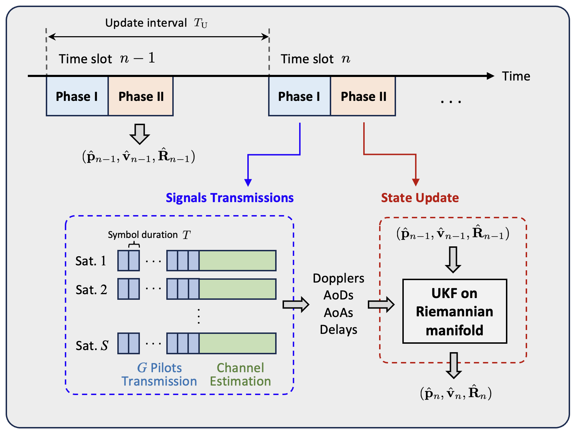
Sat. constellation
UE position tracking performance
Dynamic 9D user tracking
Urban
(RISs invisible)
Urban
(RISs visible)
Rural
Suburban
4 satellites with random orbits
RIS 1
RMSE of pos. estimation (m)
User trajectory
RIS 2

Slide 4
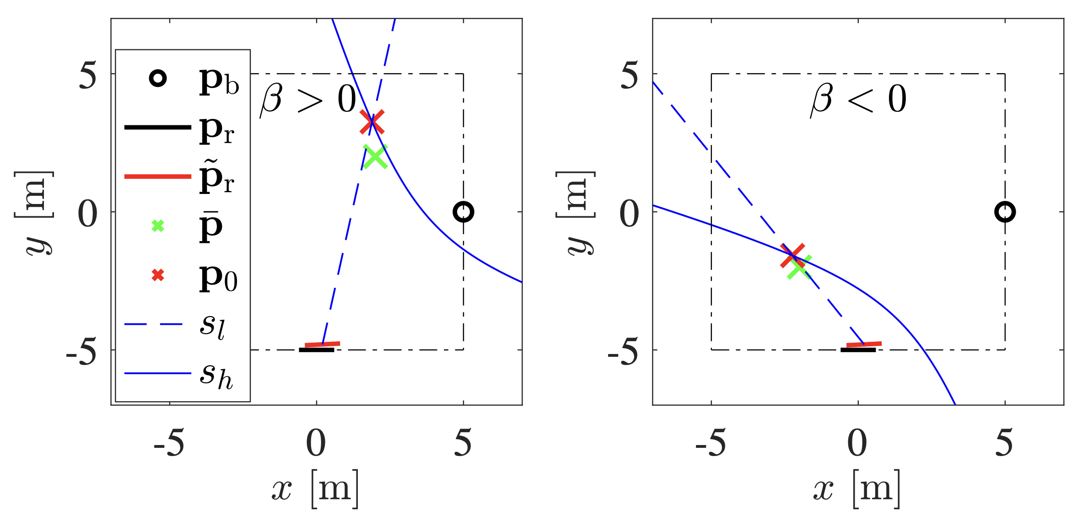
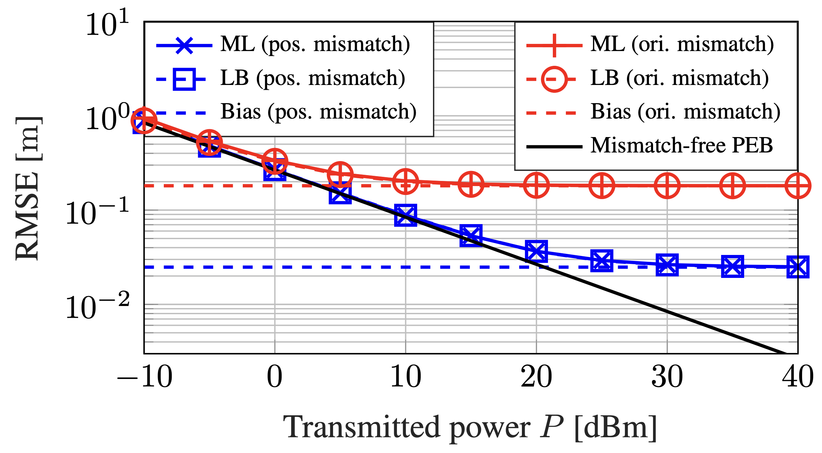

Slide 5
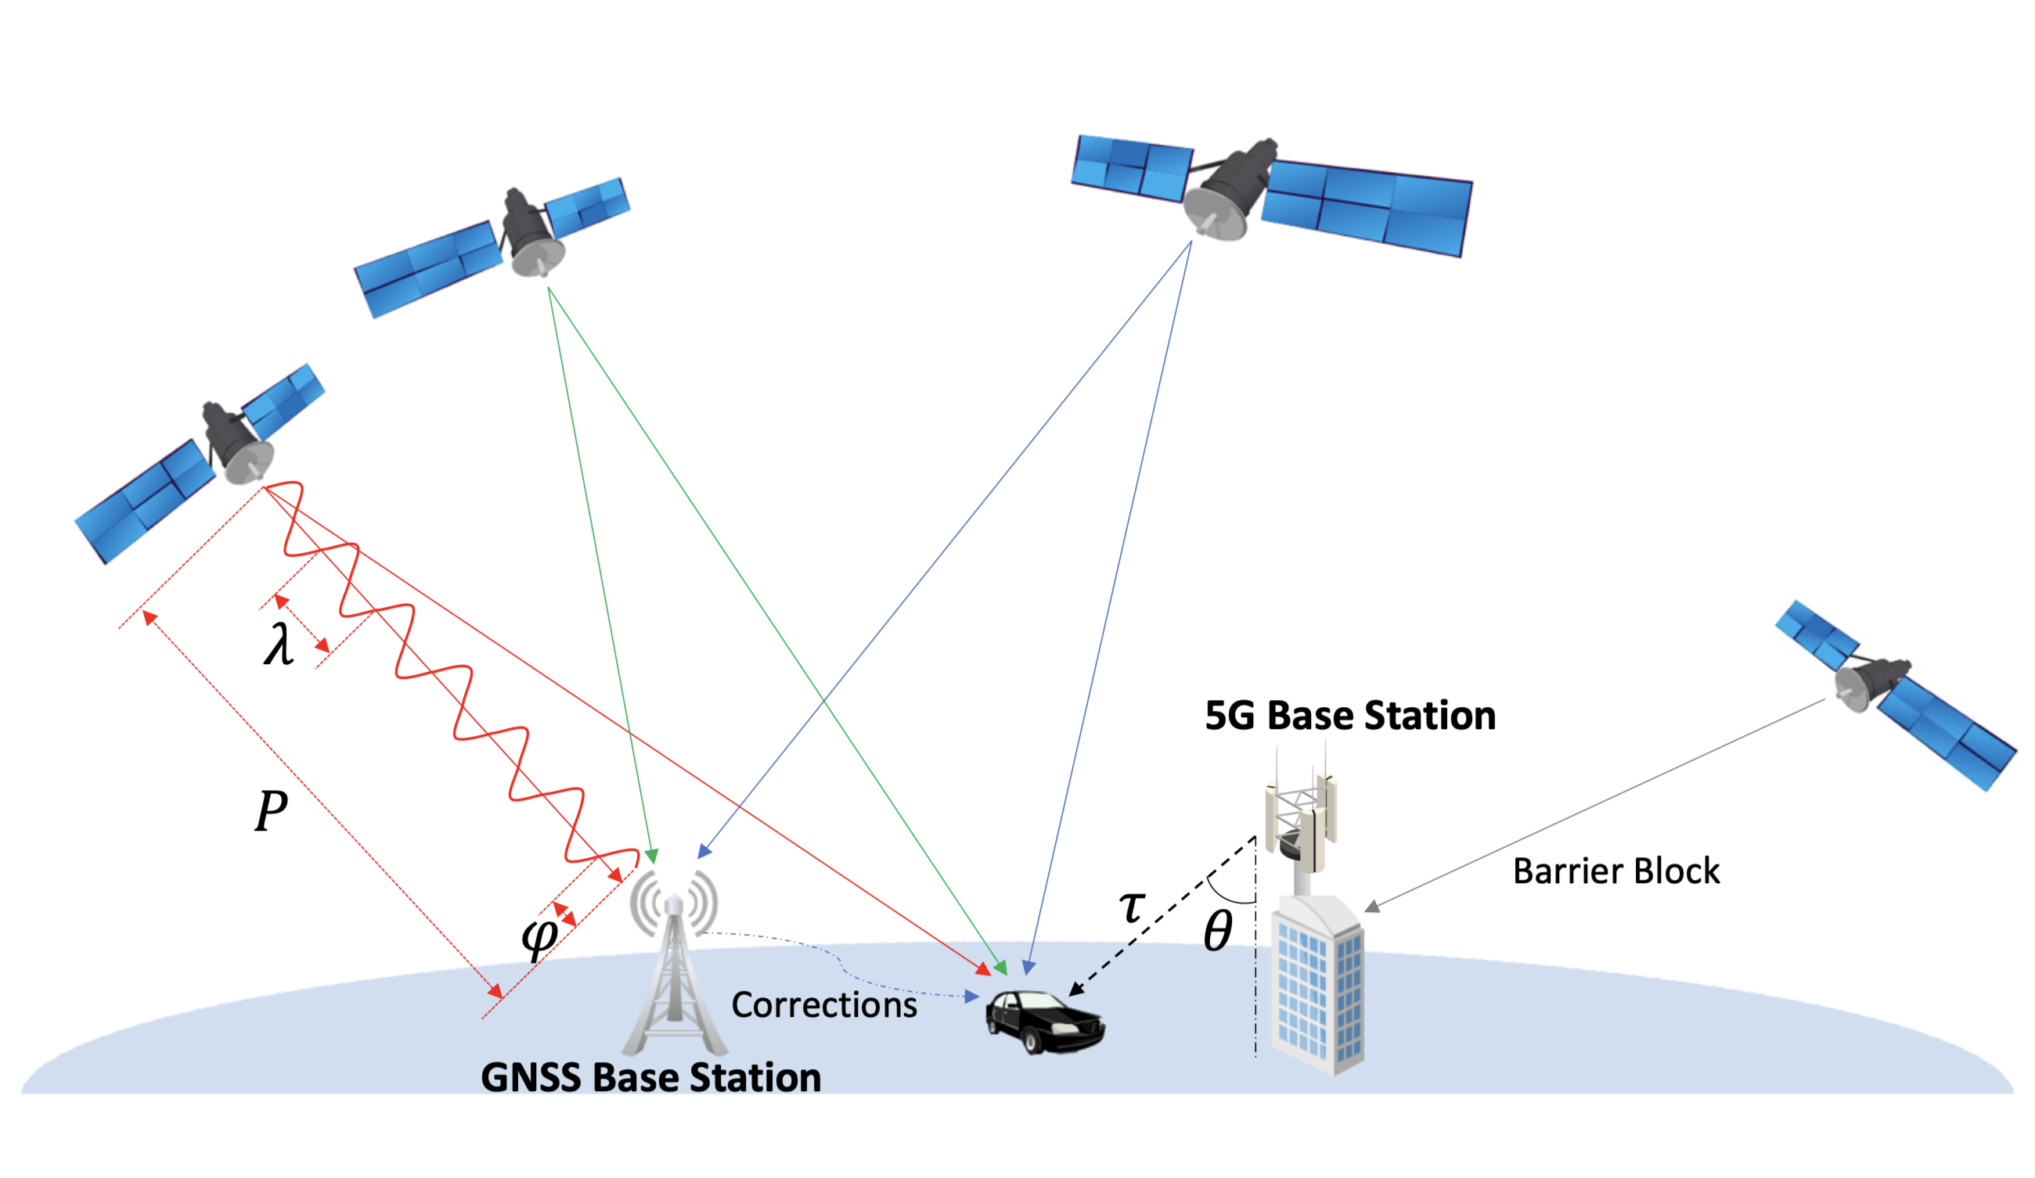

Slide 6
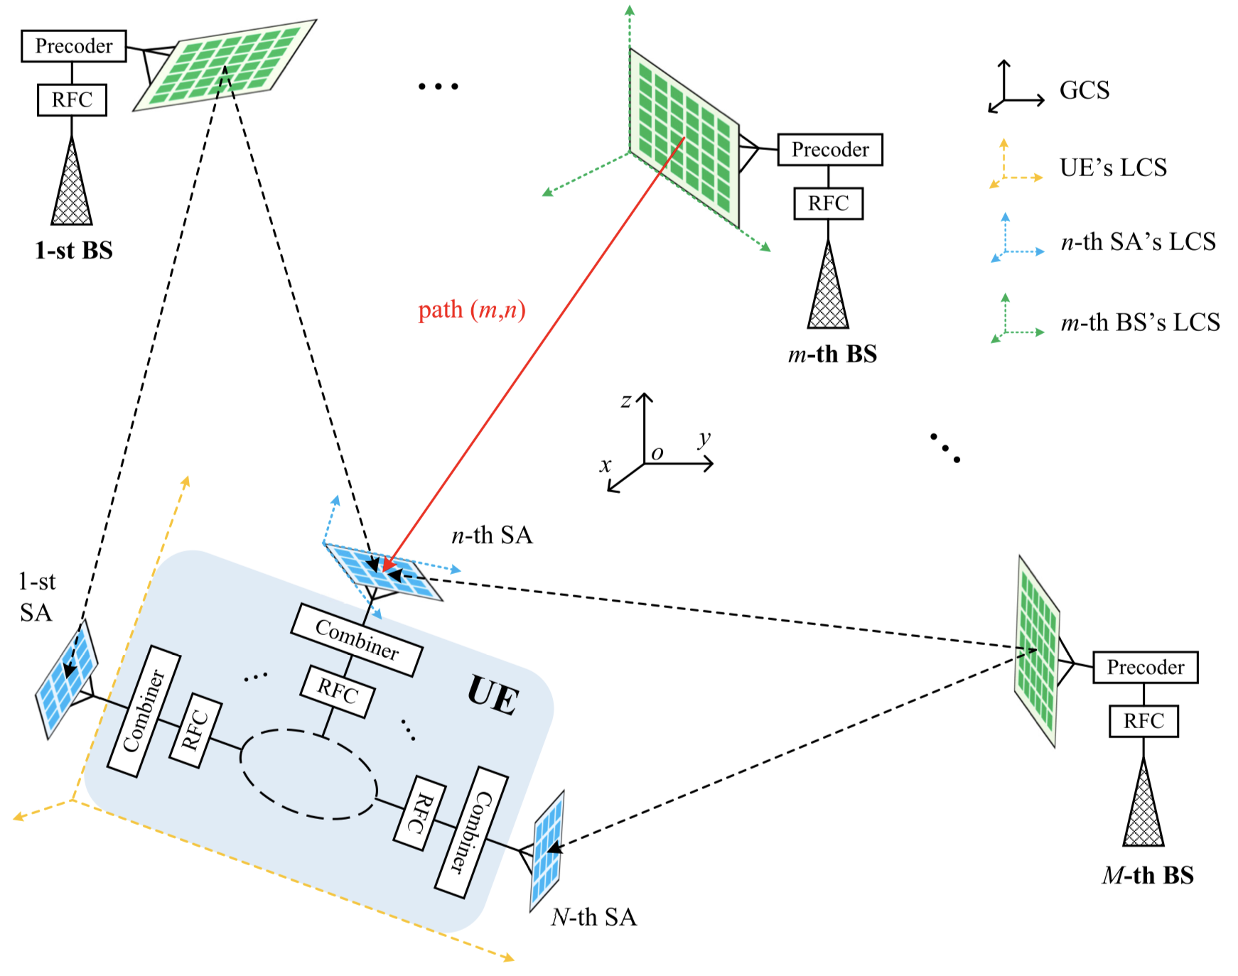

Slide 7
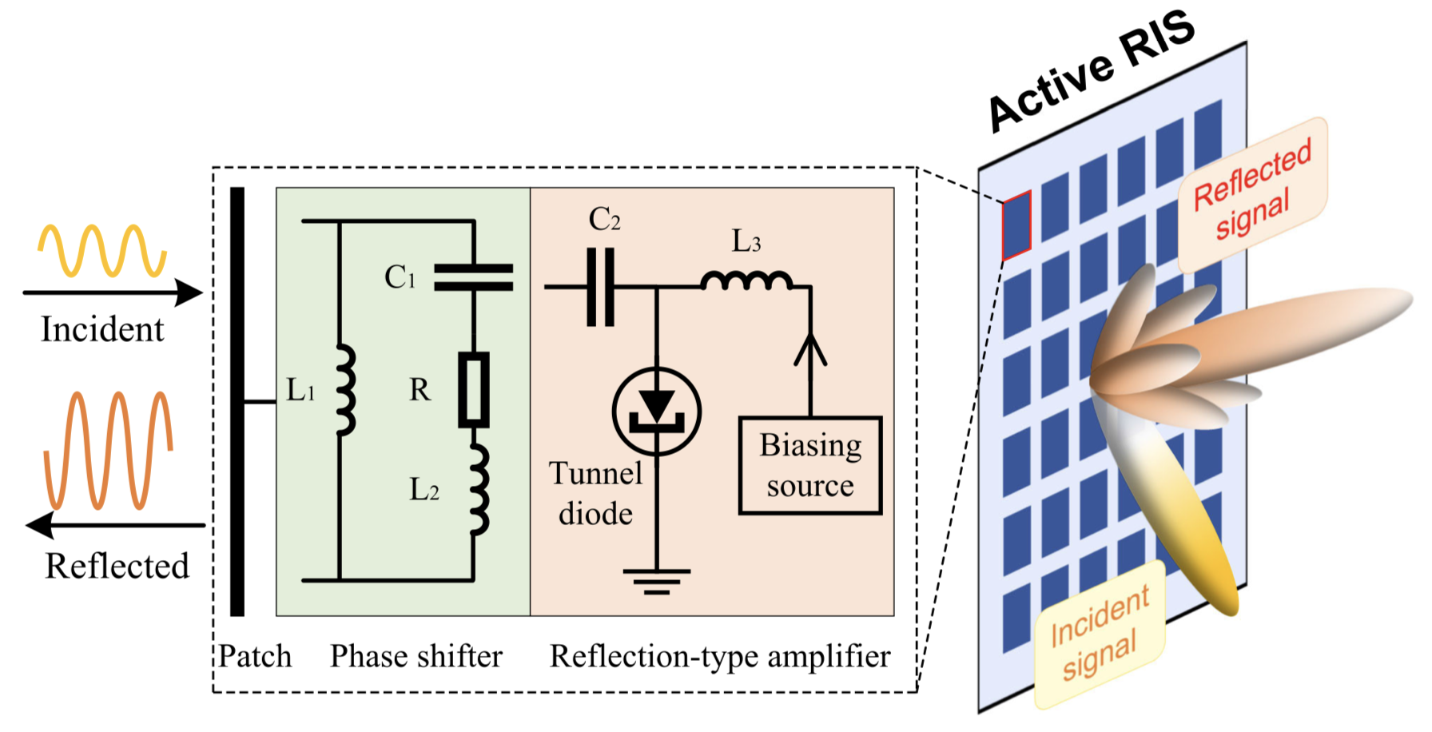
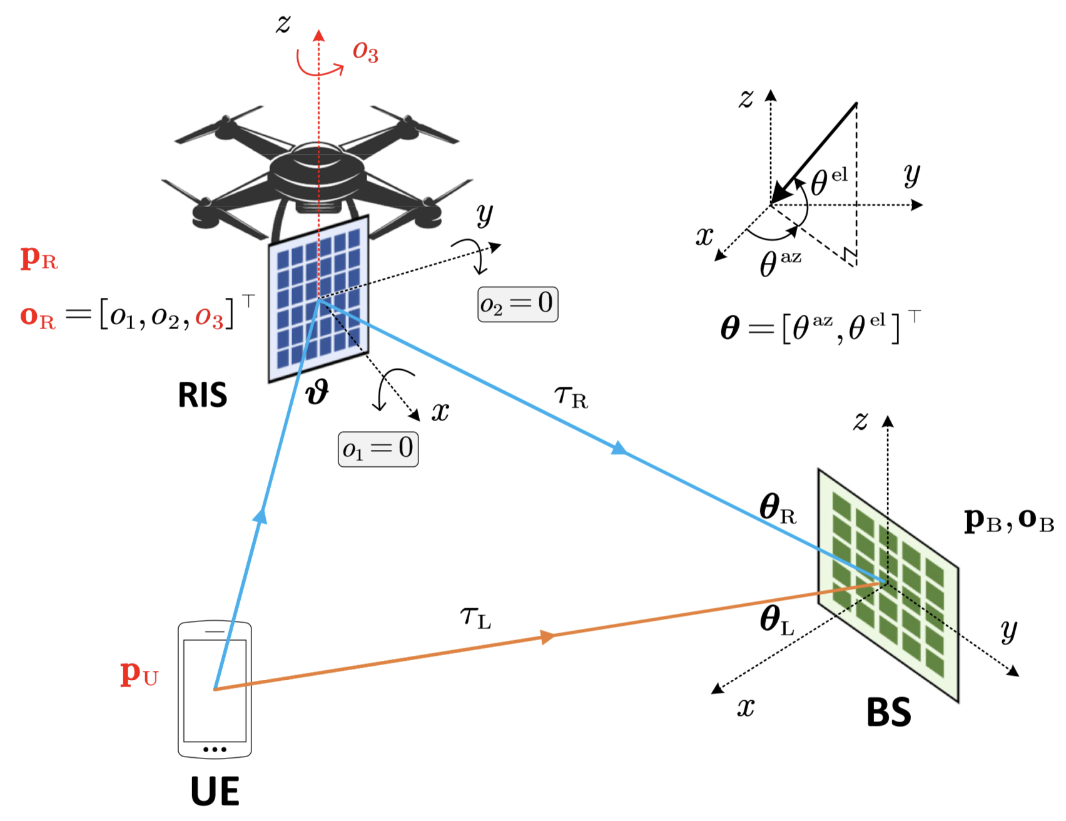

Slide 8
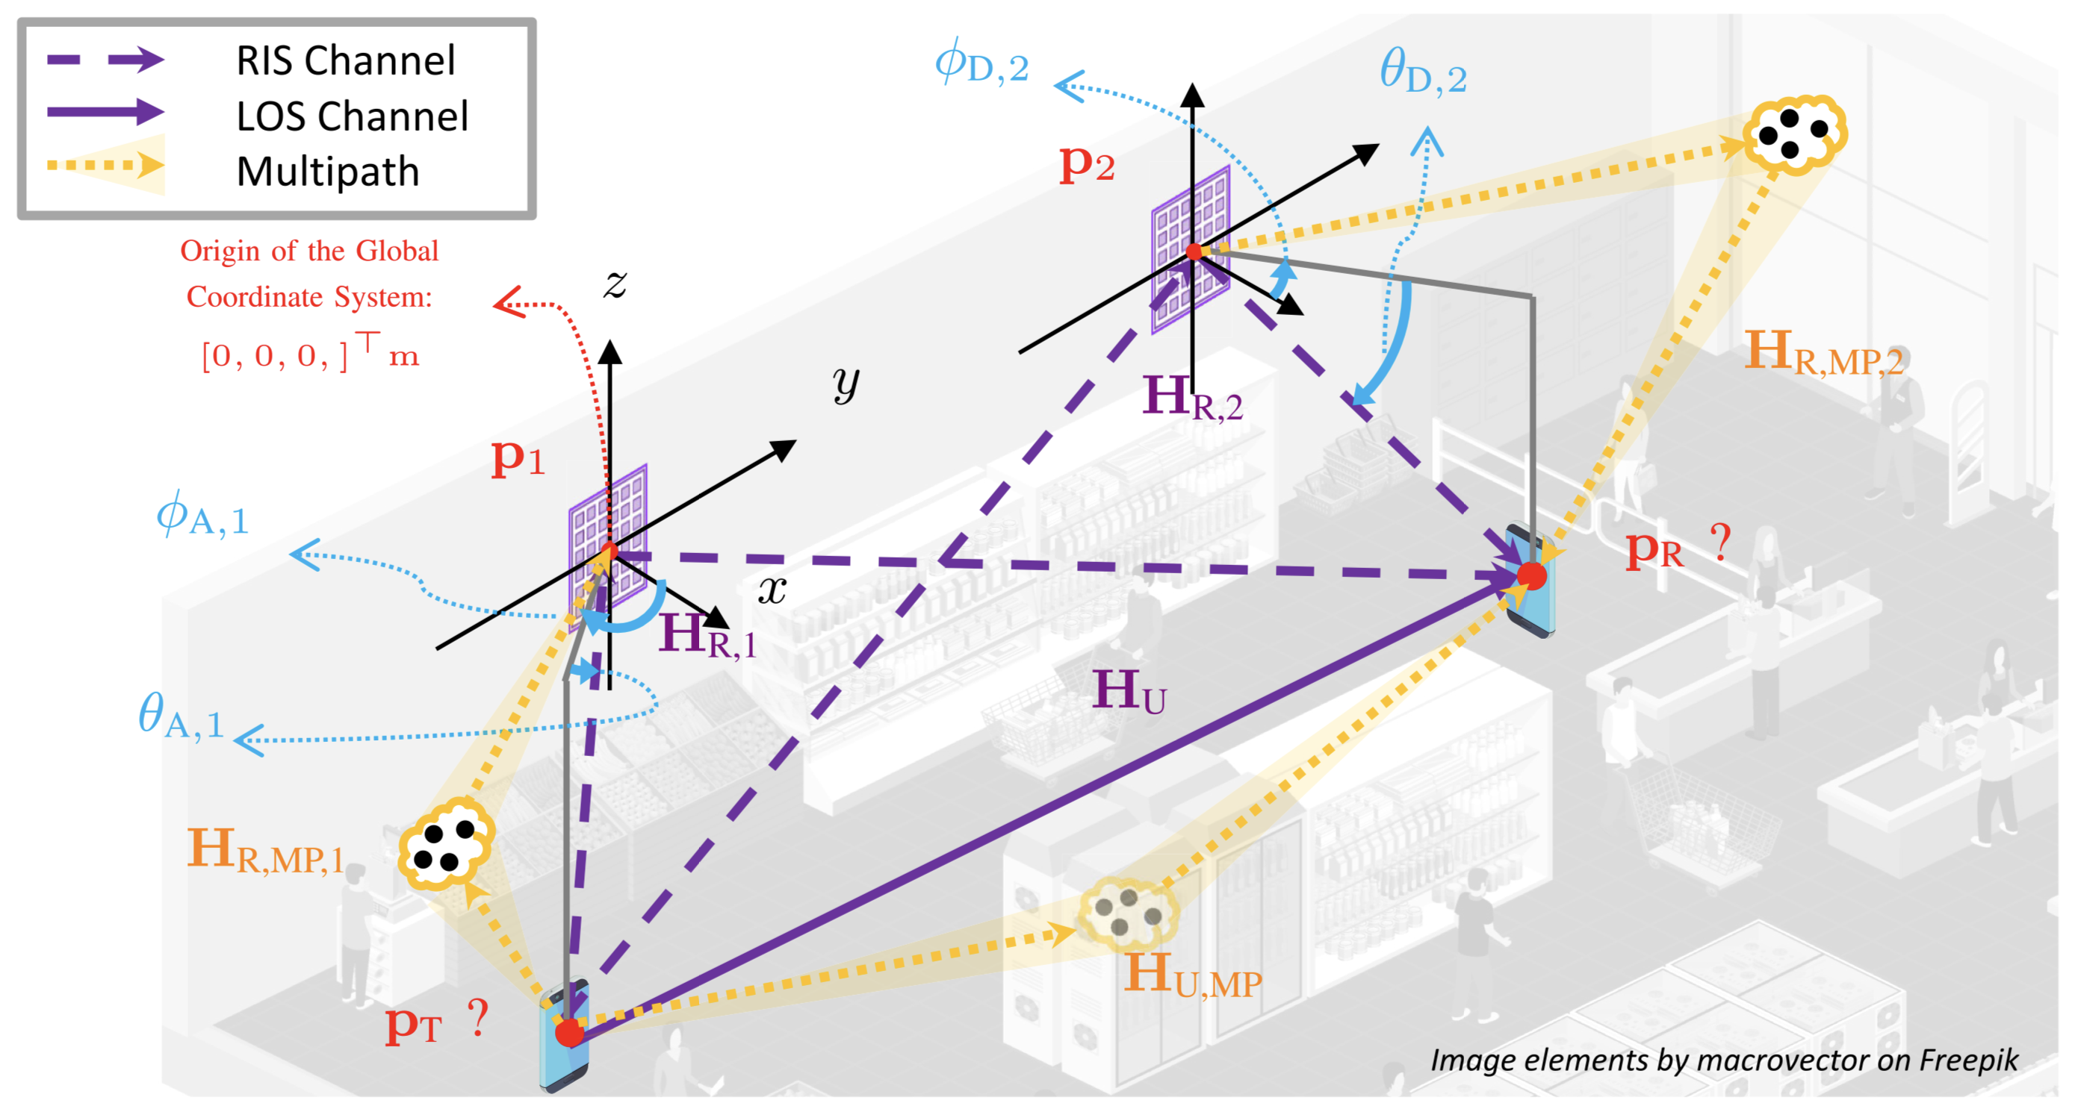

Slide 9
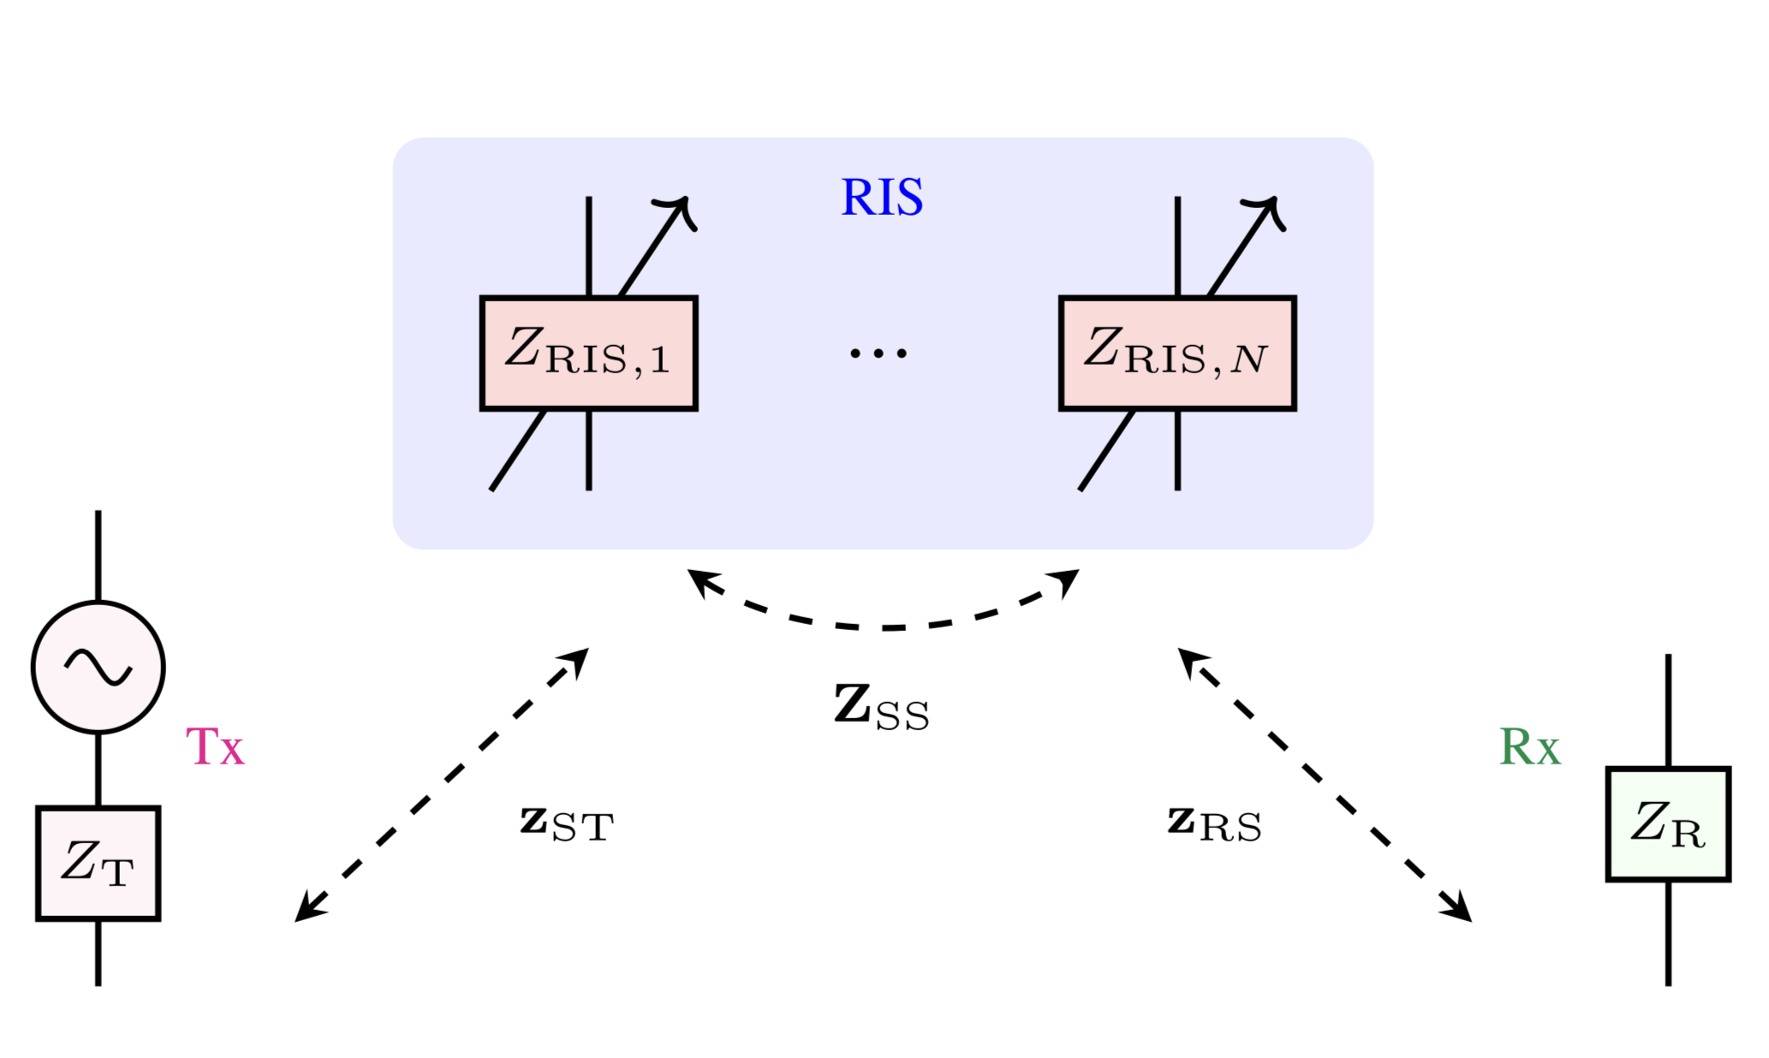
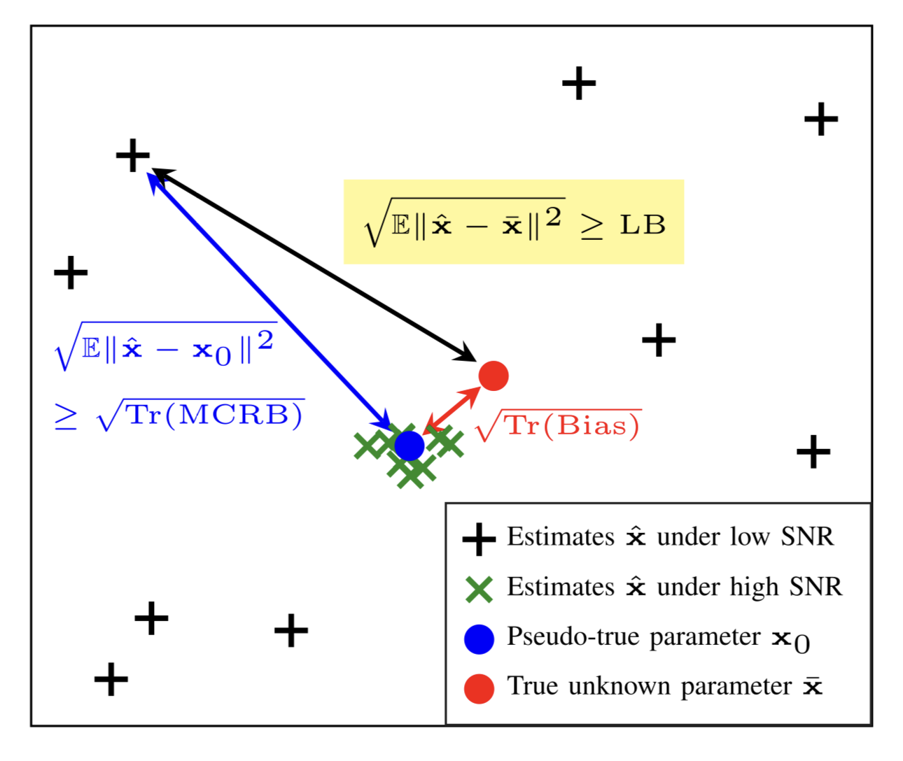

Slide 10
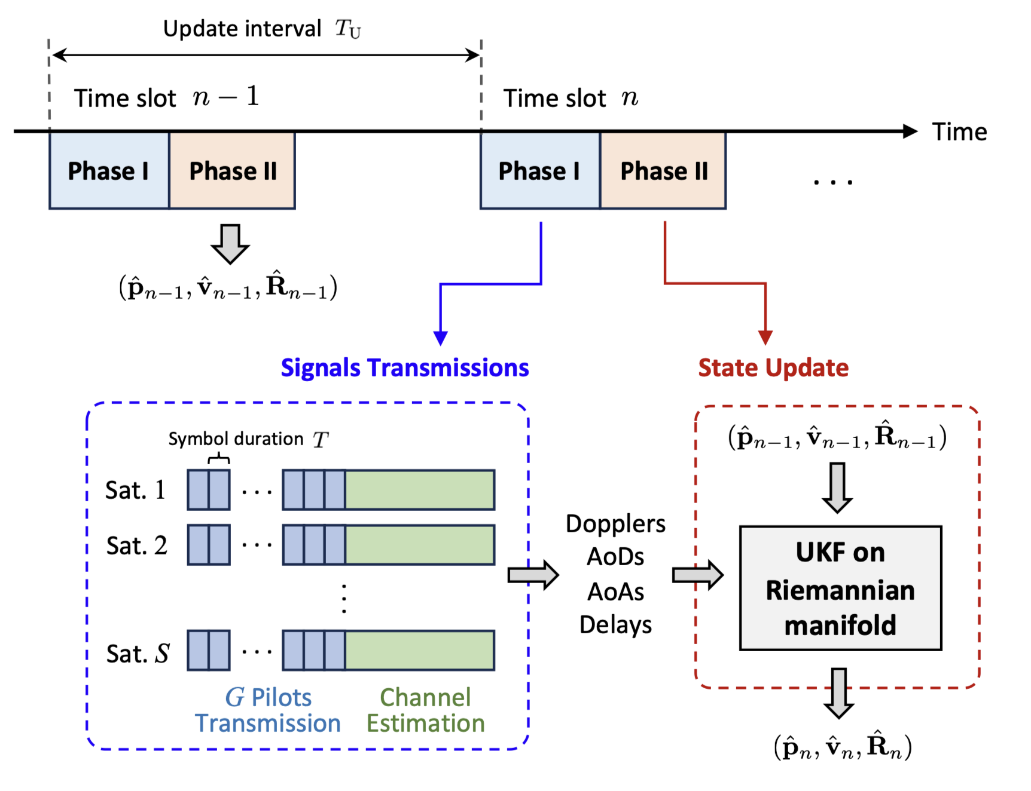

Slide 11
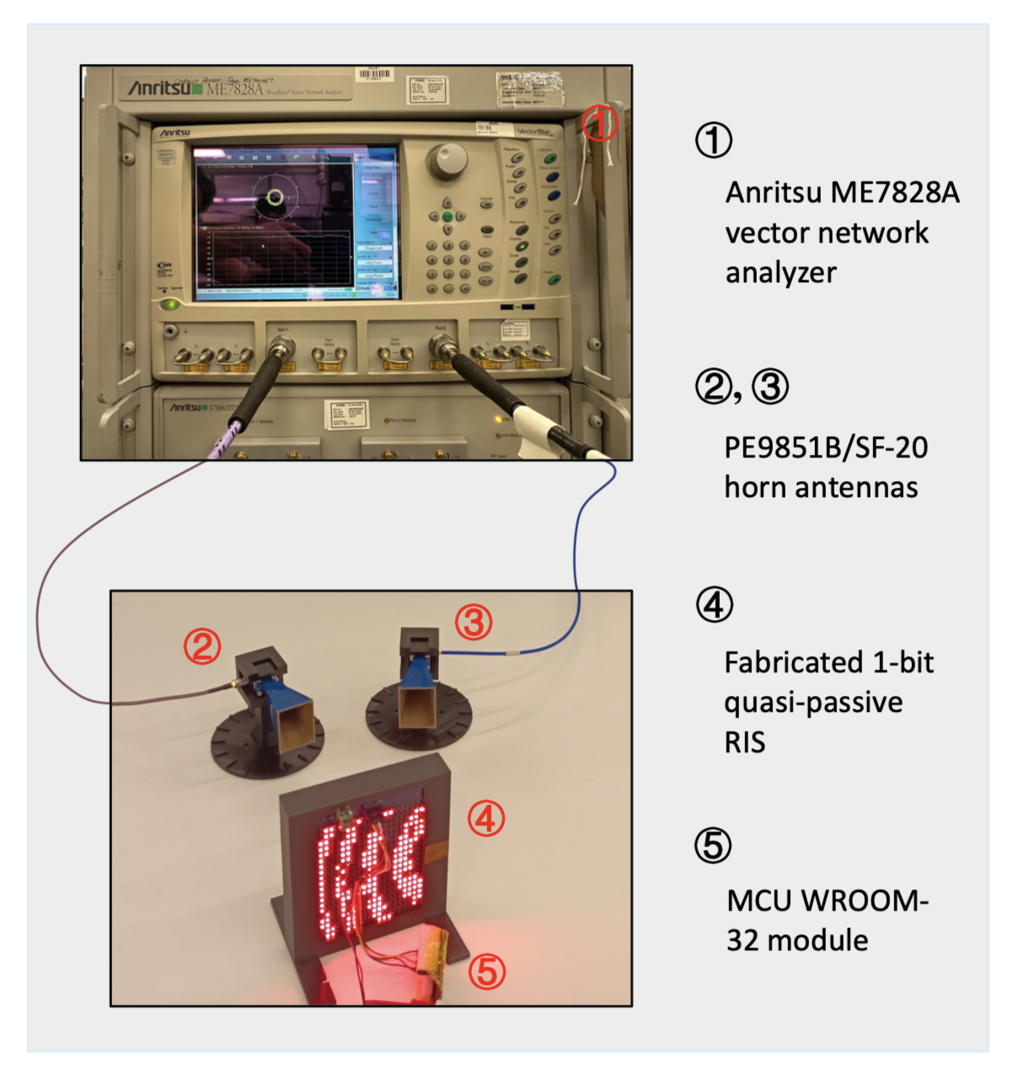
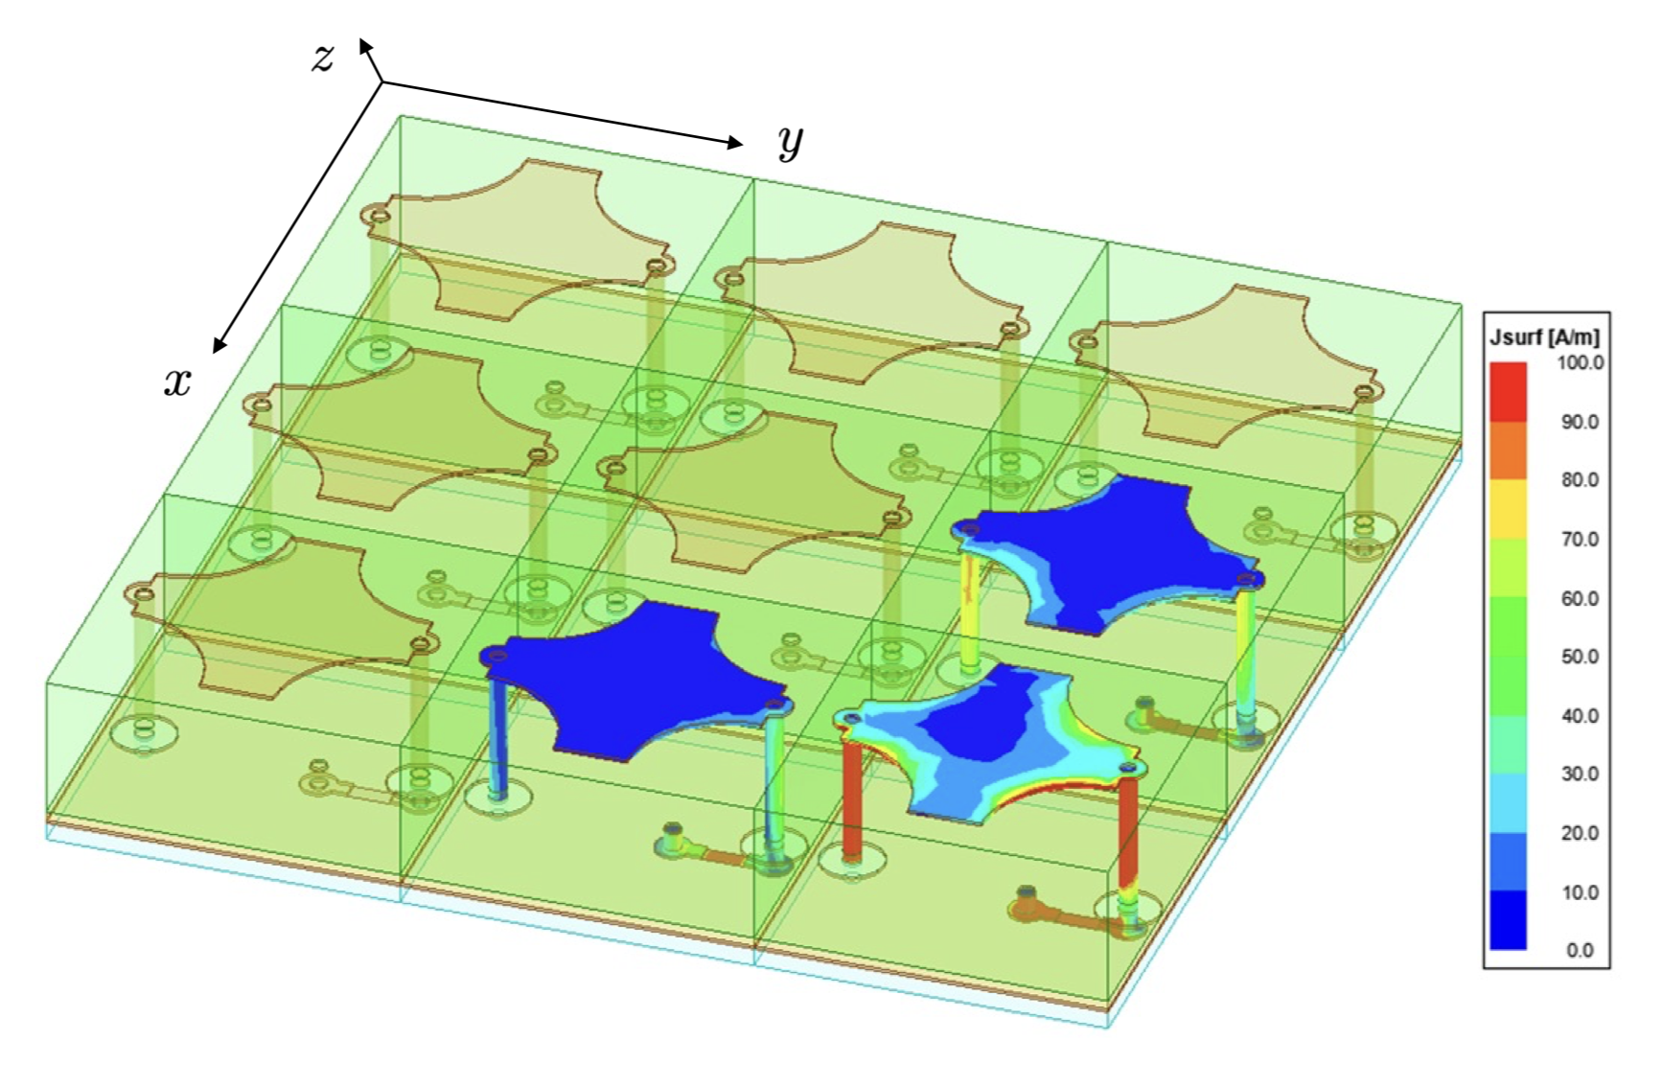
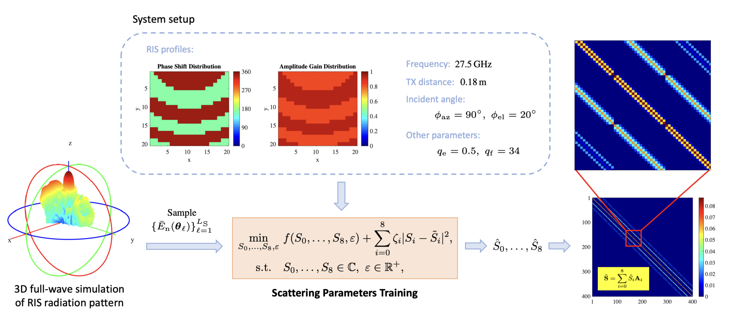

Slide 12
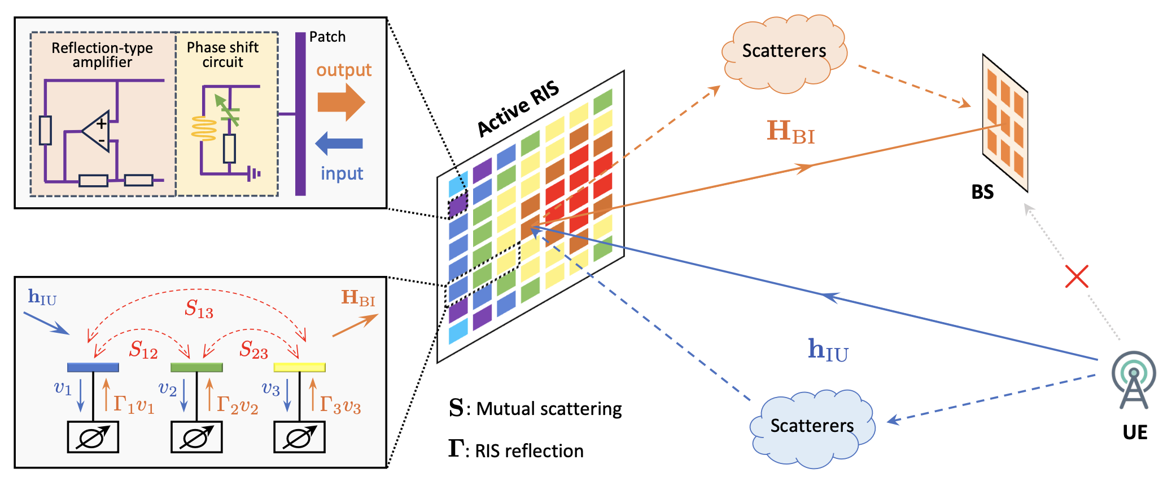
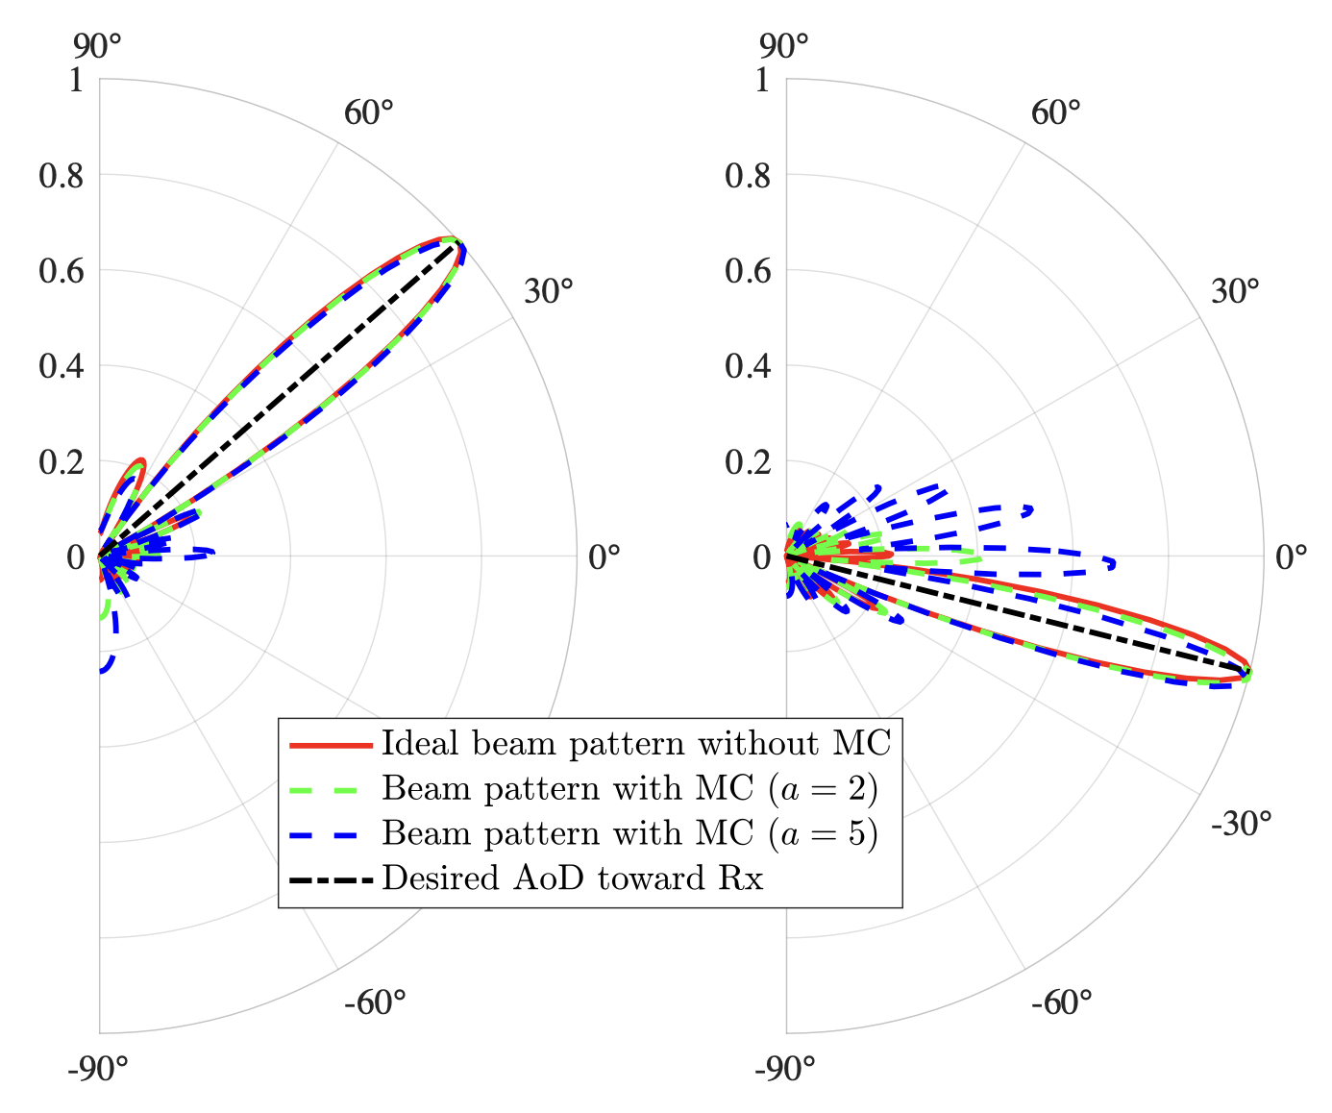

Slide 13
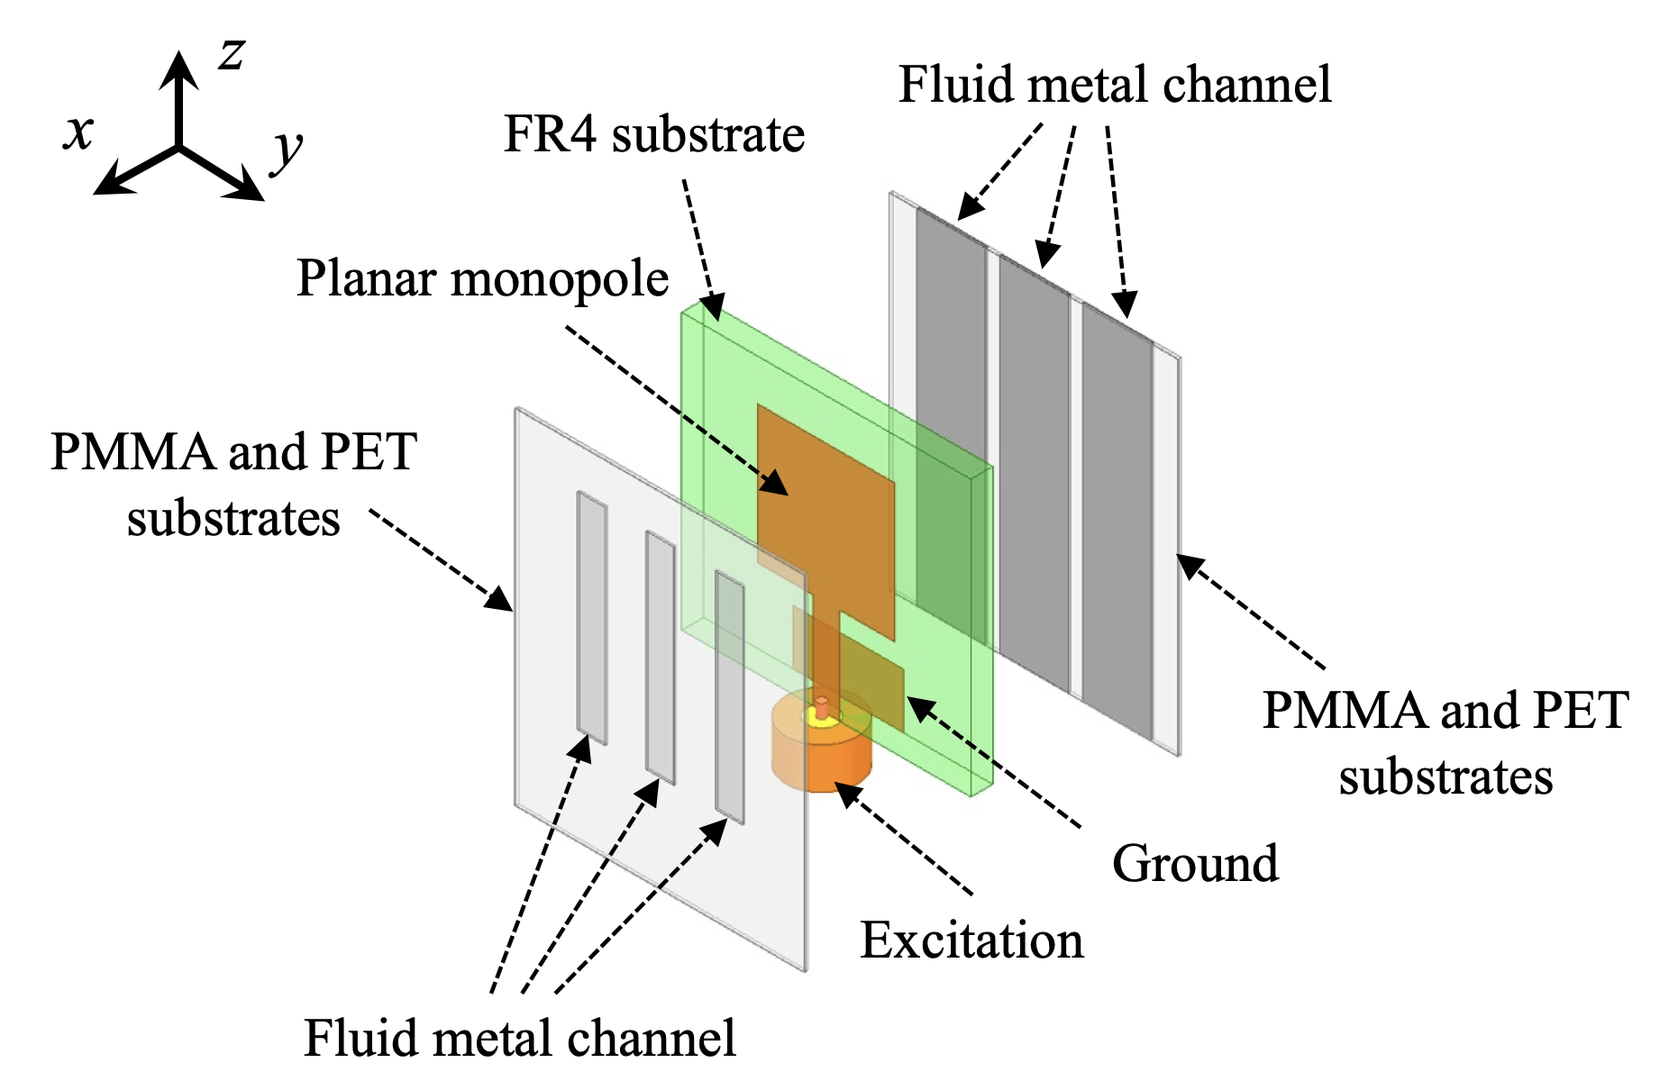
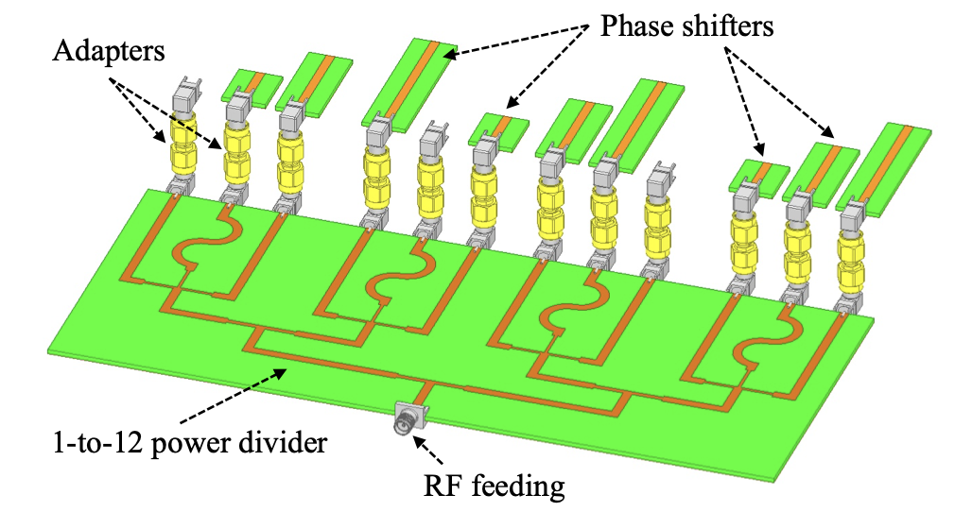
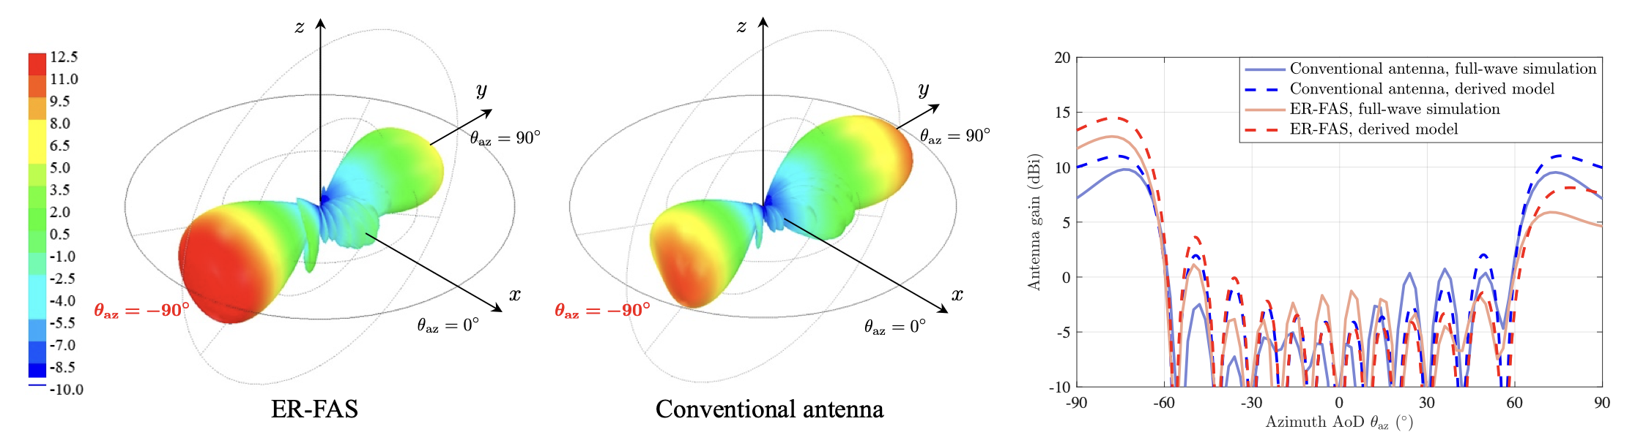
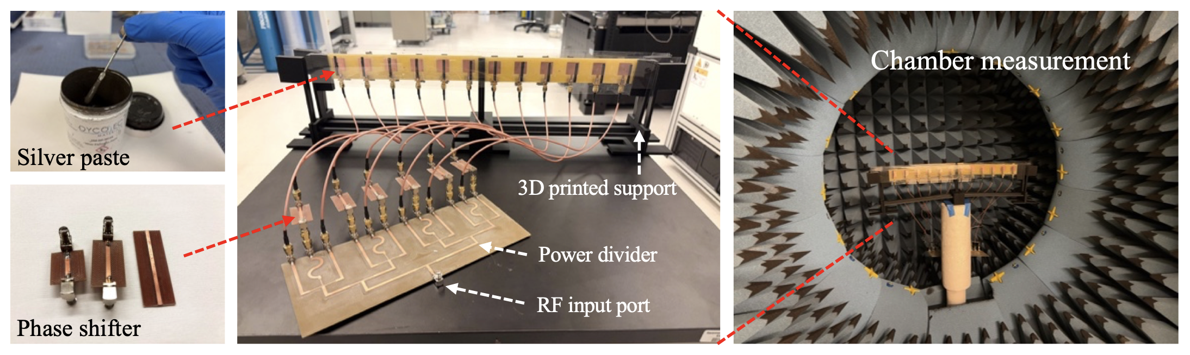

Slide 14
